Slide 1
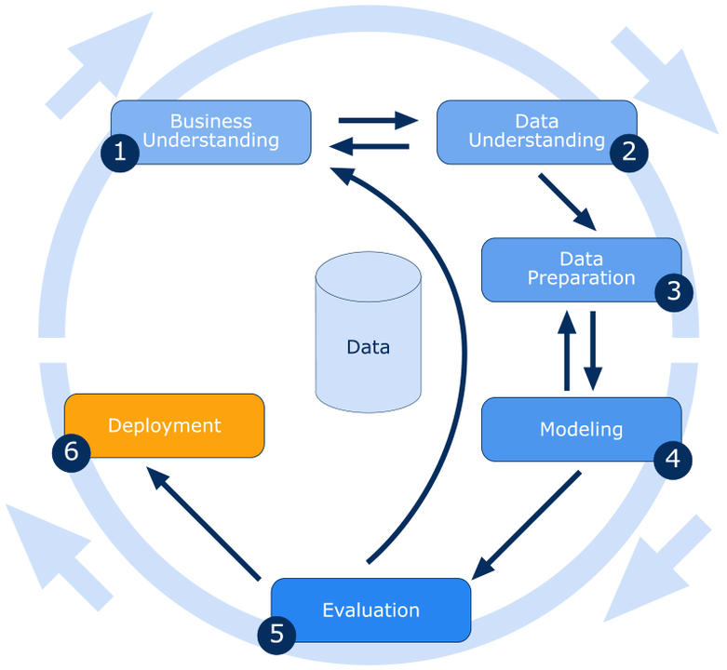
CRISP Methodology
Cross industry standard Process For Data Mining
Predication
Classification
Clustering
ARM
Reinforced Learning
Text processing
Deep learning

Slide 2
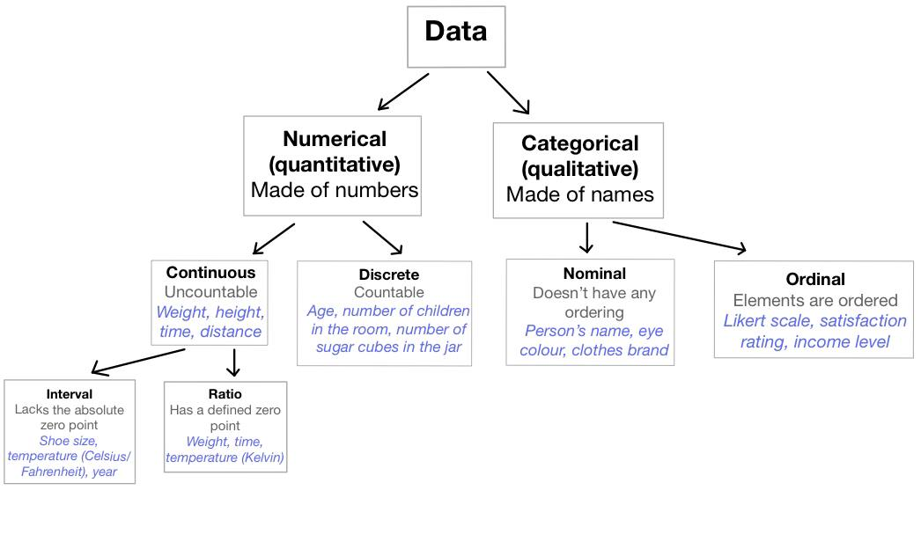

Slide 3
